Slide 1
Acoustic Detection of Room Shape
Joshua Morgan, Anish Phule, Zaiyue Lu

Slide 2
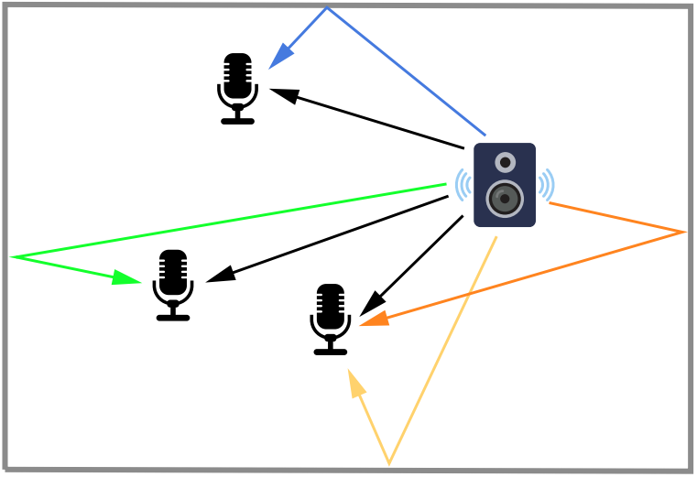
Objective
Detect the positions of walls by measuring sound of a speaker reflected by the walls at multiple locations of microphones
Measure the sound of a speaker reflected by walls at multiple locations of microphone
Implement algorithm in MATLAB to determine the positions of walls by analyzing the measured sound wave

Slide 3
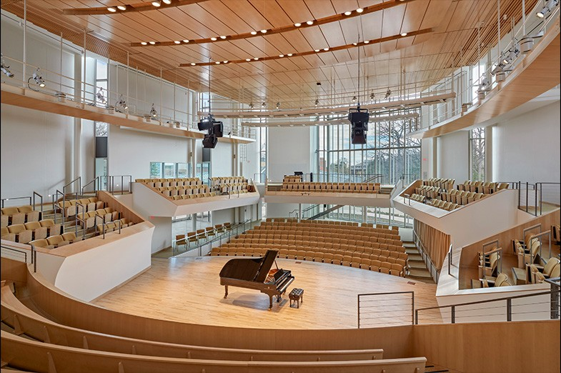
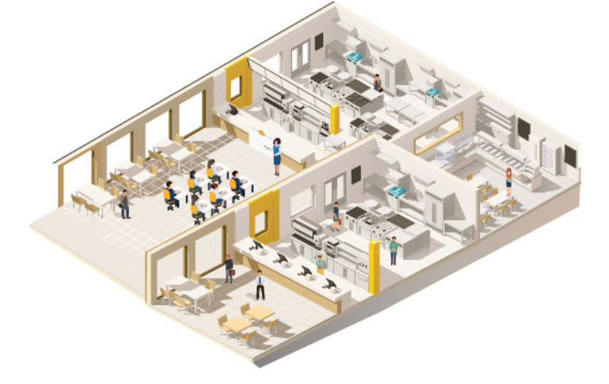
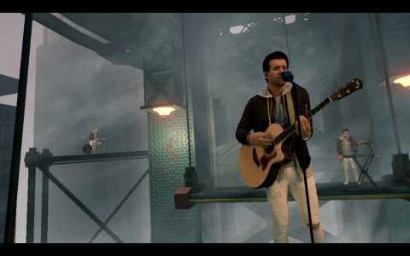
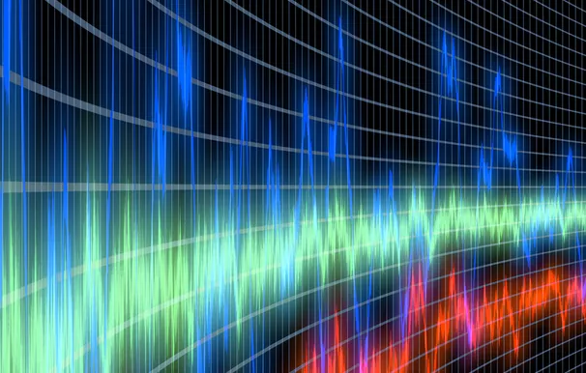
Applications
Architectural Acoustics
Indoor Positioning
Acoustic Virtual Reality
Audio Forensics

Slide 4
Relevant Works
Discuss various methods for obtaining the room impulse function
Adrian Calin Farcas, and Marina Dana Topa, “On the choice of the method for obtaining the room impulse response”, Acta Technica Napocensis 54, 34 (2003)
Stan Guy-Bart, Embrechts Jean-Jacques, and Archambeau Dominique, “Comparison of different impulse response measurement techniques”, Journal of the Audio Engineering Society 50, 249-262 (2002)
Angelo Farina, “Simultaneous Measurement of Impulse Response and Distortion With a Swept-Sine Technique”, 108th Convention, Audio Engineering Society, February 19-22, 2000, Paris, France
Reconstruct the 3D geometry of a room
I. Dokmanic, R. Parhizkar, A. Walther, Y. Lu, and M. Vetterli, “Acoustic echoes reveal room shape”, Proceedings of the National Academy of Sciences of the United States of America 110, 12186-12191 (2013)
Introduce strategy to detect position of walls with 20 cm uncertainty in microphone positions, and absorption coefficient of sound
Oliver Shih, and Anthony Rowe, “Can a Phone Hear the Shape of a Room?”, IPSN ’19: Proceedings of the 18th International Conference on Information Processing in Sensor Networks, Pages 277-288, April 16-18, 2019, Montreal, Canada

Slide 5
Image Source Model of Room Shape

Slide 6


Each reflection is equivalent to a direct path from an image source

Slide 7
Each reflection is equivalent to a direct path from an image source
Image Source
Source

Slide 8
First order image sources correspond to single reflections
Source

Slide 9
First order image sources correspond to single reflections
Image Source
(first order)
Source

Slide 10
Higher order image sources correspond to multiple reflections
Source

Slide 11
Higher order image sources correspond to multiple reflections
Image Source (second order)
Source

Slide 12
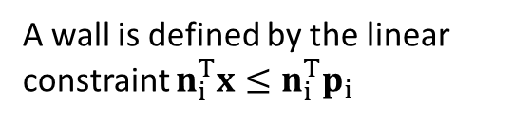
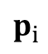
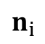
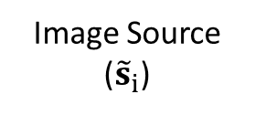
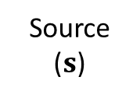
Each first order image source corresponds to a wall
A wall is defined by the linear constraint $n_{i}^{T}x≤n_{i}^{T}p_{i}$
Image Source (${\tilde{s}}_{i}$)
$$n_{i}$$
$$p_{i}$$
Source ($s$)

Slide 13
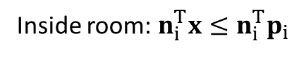
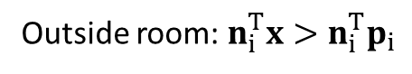
Each first order image source corresponds to a wall
Outside room: $n_{i}^{T}x>n_{i}^{T}p_{i}$
Image Source (${\tilde{s}}_{i}$)
$$n_{i}$$
$$p_{i}$$
Inside room: $n_{i}^{T}x≤n_{i}^{T}p_{i}$
Source ($s$)

Slide 14
A room is the intersection of wall constraints

Slide 15
Room Shape Estimation Algorithm

Slide 16
The room estimation algorithm determines first order image source locations from received signals
Transmitted Signal
Received Signals
Impulse Response Estimation
Echo Time-of-Flights
Speaker and Image Source Localization
Candidate Image Sources
Remove Incorrect Image Sources
First Order Image Sources
Cuboid Fit
Room Dimensions

Slide 17
The room estimation algorithm determines first order image source locations from received signals
Transmitted Signal
Received Signals
Impulse Response Estimation
Echo Time-of-Flights
Speaker and Image Source Localization
Candidate Image Sources
Remove Incorrect Image Sources
First Order Image Sources
Cuboid Fit
Room Dimensions

Slide 18
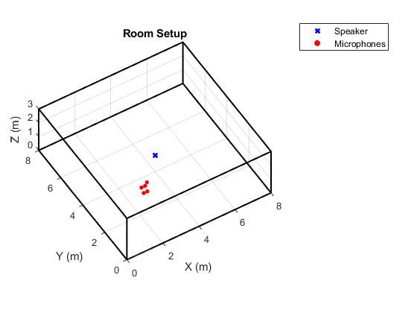
A single speaker and multiple microphones are placed in the room

Slide 19

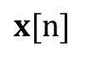
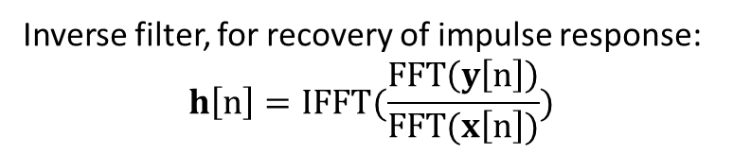
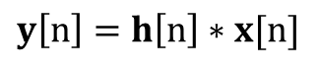
Each microphone has its own impulse response
Transmitted Signal
Room Impulse Response
Received Signal
$$x[n]$$
$$h[n]$$
$$y\left[n\right]=h\left[n\right]∗x[n]$$
Inverse filter, for recovery of impulse response:
$$h\left[n\right]=IFFT(\frac{FFT\left(y\left[n\right]\right)}{FFT(x\left[n\right])})$$

Slide 20
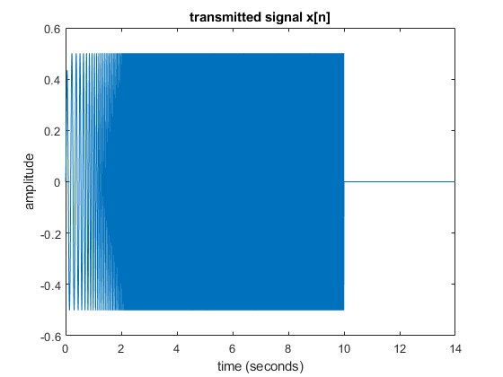

The transmitted signal is a sine sweep covering a frequency range of 5 Hz to 22.05 kHz
$$h\left[n\right]=IFFT(\frac{FFT\left(y\left[n\right]\right)}{FFT(x\left[n\right])})$$

Slide 21
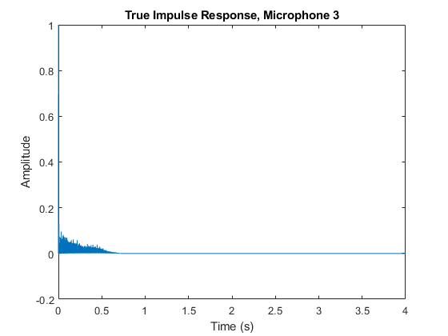
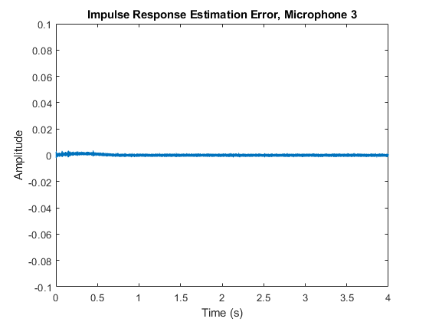
In simulation, the inverse filter effectively recovers the room impulse response

Slide 22
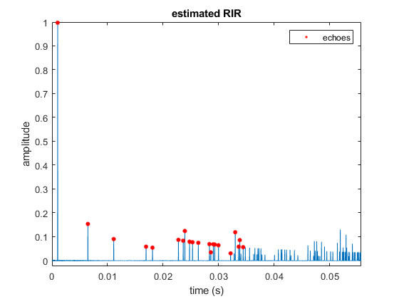
Echo times are extracted from the room impulse responses
First peak corresponds to direct path

Slide 23
The room estimation algorithm determines first order image source locations from received signals
Transmitted Signal
Received Signals
Impulse Response Estimation
Echo Time-of-Flights
Speaker and Image Source Localization
Candidate Image Sources
Remove Incorrect Image Sources
First Order Image Sources
Cuboid Fit
Room Dimensions

Slide 24
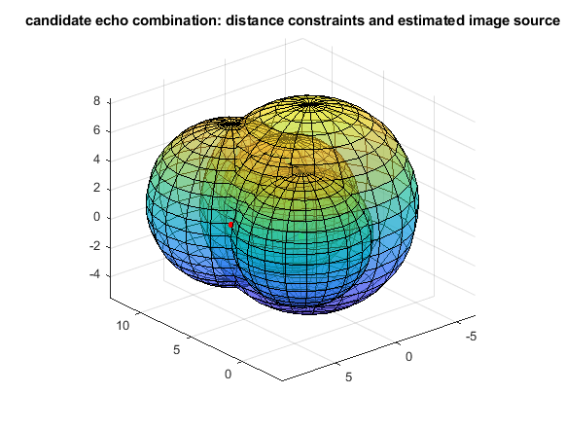
Each time-of-flight defines a spherical constraint, and the image source can be found using the intersection of constraints
Z (m)
Y (m)
X (m)
: estimated image source location

Slide 25
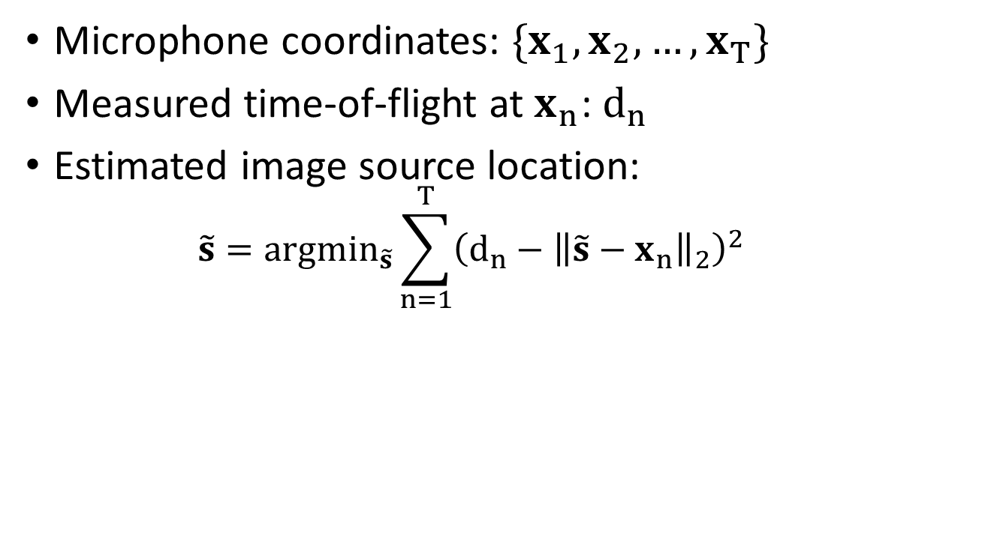
Each image source location is derived from a nonlinear least squares fit
Microphone coordinates: $\{x_{1},x_{2},…,x_{T}\}$
Measured time-of-flight at $x_{n}$: $d_{n}$
Estimated image source location:
$$\tilde{s}=argmin_{\tilde{s}}\sum_{n=1}^{T}{{\left(d_{n}−{\left\|\tilde{s}−x_{n}\right\|}_{2}\right)}^{2}}$$

Slide 26
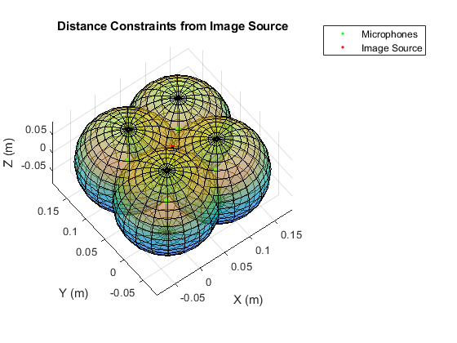
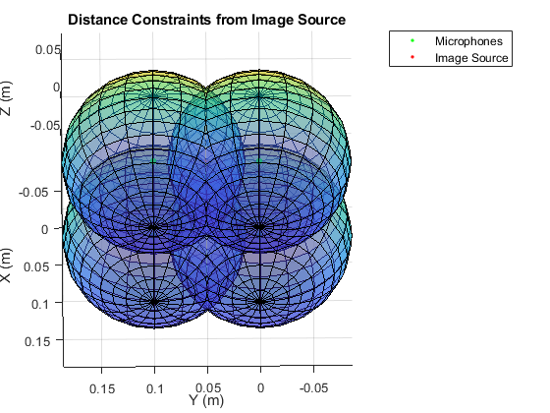
If microphones are placed on a 2D plane, the image source fit has multiple solutions
Top View:
Bottom View:

Slide 27
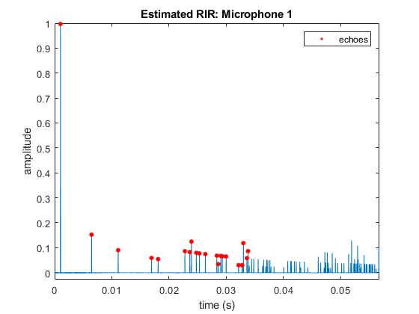
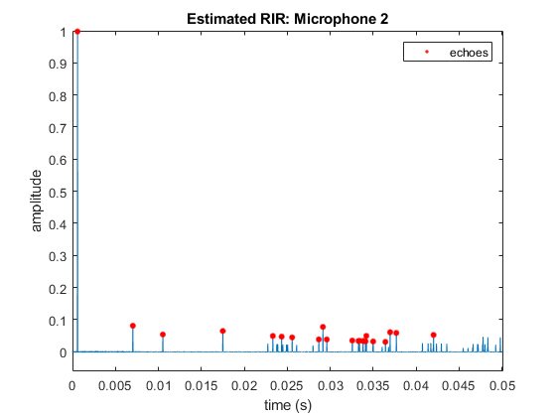
It is difficult to determine corresponding echo measurements between each impulse response

Slide 28
It is difficult to determine corresponding echo measurements between each impulse response
Use first peak as direct path for speaker localization

Slide 29
It is difficult to determine corresponding echo measurements between each impulse response
Do these echoes come from the same image source?

Slide 30
It is difficult to determine corresponding echo measurements between each impulse response
Do these echoes come from the same image source?

Slide 31
It is difficult to determine corresponding echo measurements between each impulse response
Do these echoes come from the same image source?

Slide 32
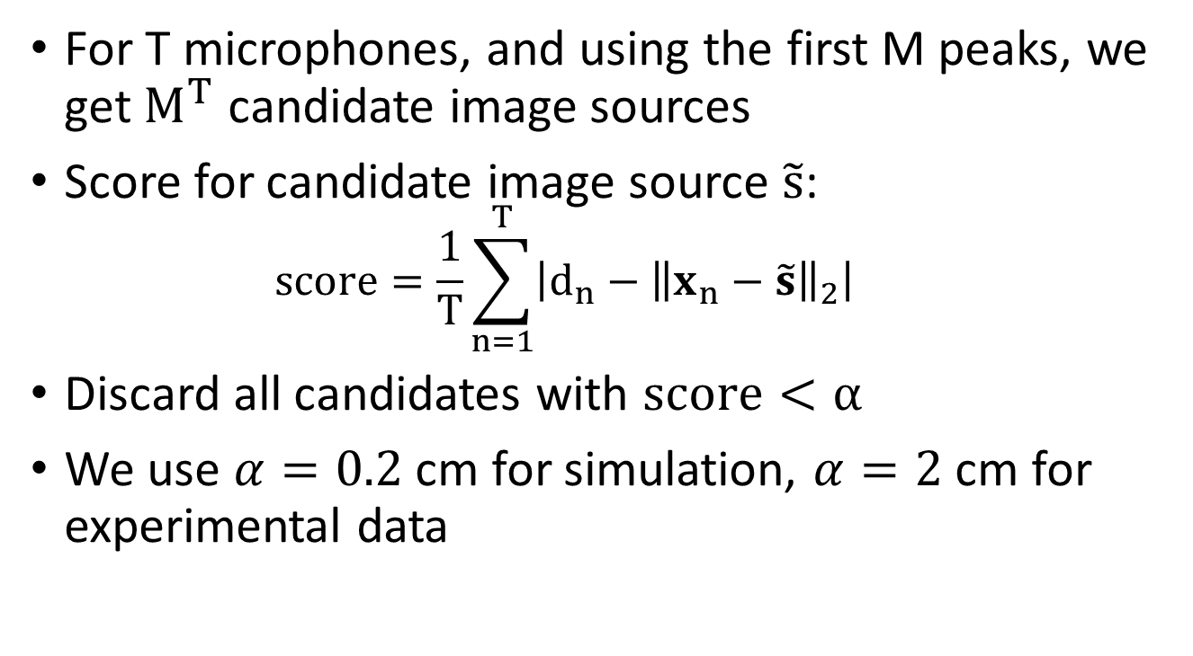
Source localization is attempted at each possible combination of echoes
For T microphones, and using the first M peaks, we get $M^{T}$ candidate image sources
Score for candidate image source $\tilde{s}$:
$$score=\frac{1}{T}\sum_{n=1}^{T}{\left|d_{n}−{\left\|x_{n}−\tilde{s}\right\|}_{2}\right|}$$
Discard all candidates with $score<α$
We use $α=0.2$ cm for simulation, $α=2$ cm for experimental data

Slide 33
The computational burden is greatly reduced by the intermicrophone distance criteria
Do not attempt matching echoes which are farther apart than the distance between microphones
This constraint is more useful if microphones are placed close together, and farther away from the room center

Slide 34
The room estimation algorithm determines first order image source locations from received signals
Transmitted Signal
Received Signals
Impulse Response Estimation
Echo Time-of-Flights
Speaker and Image Source Localization
Candidate Image Sources
Remove Incorrect Image Sources
First Order Image Sources
Cuboid Fit
Room Dimensions

Slide 35
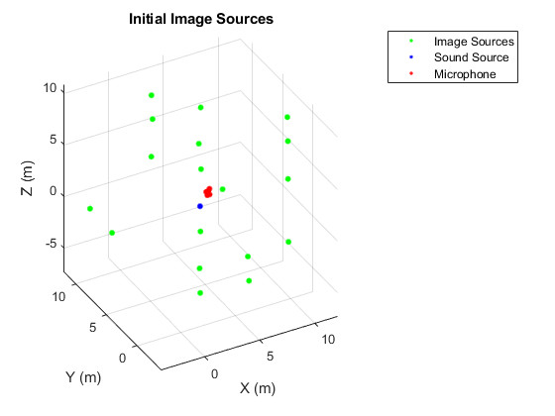
The set of candidate image sources contains higher order sources

Slide 36
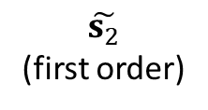
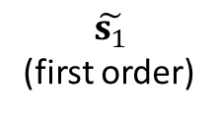
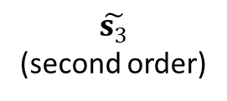
Higher order sources are represented as combinations of lower order sources
$$\tilde{s_{1}}$$
(first order)
$$\tilde{s_{3}}$$
(second order)
$$\tilde{s_{2}}$$
(first order)
Source

Slide 37
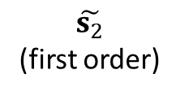
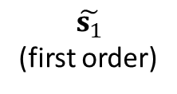
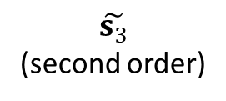
Higher order sources are represented as combinations of lower order sources
$$\tilde{s_{1}}$$
(first order)
$$\tilde{s_{3}}$$
(second order)
$$\tilde{s_{2}}$$
(first order)
Source

Slide 38
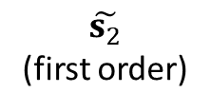
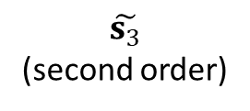
Higher order sources are represented as combinations of lower order sources
$$\tilde{s_{1}}$$
(first order)
$$\tilde{s_{3}}$$
(second order)
$$\tilde{s_{2}}$$
(first order)
Source

Slide 39
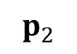
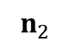
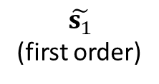
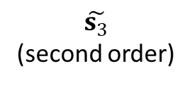
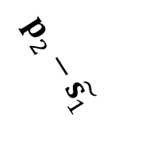
Higher order sources are represented as combinations of lower order sources
$$\tilde{s_{1}}$$
(first order)
$$\tilde{s_{3}}$$
(second order)
$$p_{2}−\tilde{s_{1}}$$
$$\tilde{s_{2}}$$
(first order)
$$n_{2}$$
$$p_{2}$$
Source

Slide 40
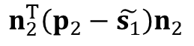
Higher order sources are represented as combinations of lower order sources
$$\tilde{s_{1}}$$
(first order)
$$\tilde{s_{3}}$$
(second order)
$$n_{2}^{T}\left(p_{2}−\tilde{s_{1}}\right)n_{2}$$
$$\tilde{s_{2}}$$
(first order)
$$n_{2}$$
$$p_{2}$$
Source

Slide 41
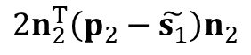
Higher order sources are represented as combinations of lower order sources
$$\tilde{s_{1}}$$
(first order)
$$\tilde{s_{3}}$$
(second order)
$${2n}_{2}^{T}\left(p_{2}−\tilde{s_{1}}\right)n_{2}$$
$$\tilde{s_{2}}$$
(first order)
$$n_{2}$$
$$p_{2}$$
Source

Slide 42
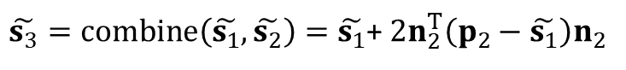
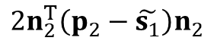
Higher order sources are represented as combinations of lower order sources
$$\tilde{s_{1}}$$
(first order)
$$\tilde{s_{3}}$$
(second order)
$${2n}_{2}^{T}\left(p_{2}−\tilde{s_{1}}\right)n_{2}$$
$\tilde{s_{3}}=combine\left(\tilde{s_{1}},\tilde{s_{2}}\right)=\tilde{s_{1}}$+ ${2n}_{2}^{T}\left(p_{2}−\tilde{s_{1}}\right)n_{2}$
$$\tilde{s_{2}}$$
(first order)
$$n_{2}$$
$$p_{2}$$
Source

Slide 43
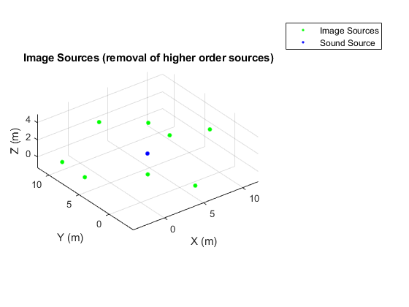
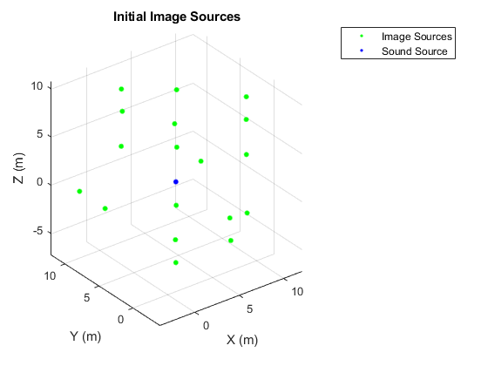
Higher order sources are identified and removed using the combination test

Slide 44
The room estimation algorithm determines first order image source locations from received signals
Transmitted Signal
Received Signals
Impulse Response Estimation
Echo Time-of-Flights
Speaker and Image Source Localization
Candidate Image Sources
Remove Incorrect Image Sources
First Order Image Sources
Cuboid Fit
Room Dimensions

Slide 45
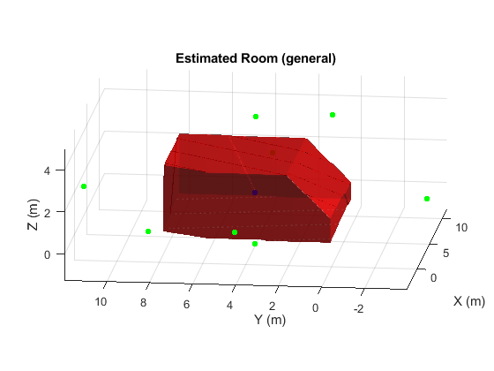
The final list of first order image sources has false positives which distort the estimated room shape
The groundtruth room is an (8 m)x(8 m)x(3 m) cuboid

Slide 46
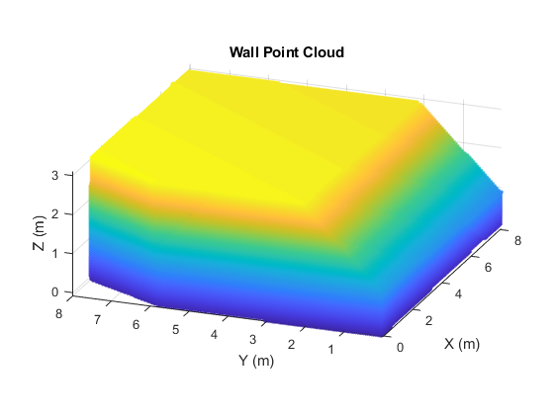
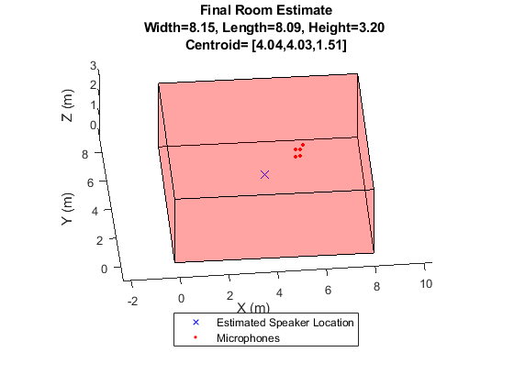
A point cloud cuboid fitting algorithm produces the final room shape estimate

Slide 47
Simulation Results

Slide 48




In simulation, the room shape is successfully extracted

Slide 49




Performance degrades as the microphone array moves farther from the center
Failed shape extraction

Slide 50
Experimental Setup

Slide 51
Experimental Setup
Requirements:
Need to setup Microphone and Speaker to get the reflection data
Need a specific signal to be played
The microphone and speaker need to work synchronously to have minimum lag

Slide 52
Experimental Setup(Software)
MATLAB function : AudioPlayerRecorder
Simultaneously plays and records via an audio device
Plays audio samples to and records audio samples from an audio device in real time.
Only Issue: The device recording and playing the audio must be the same.
Solution: Audio interface.

Slide 53

Experimental Setup(Software)
Audio Signal:
Sweep tone function.
Exponential swept sine signal for t seconds, followed by silence of ts seconds.

Slide 54





Experimental Setup(Hardware)
Audio
Interface

Slide 55

Experimental Setup(Hardware)
Audio
Interface

Slide 56



Experimental Setup(Hardware)
Audio
Interface

Slide 57


Experimental Setup(Hardware)
Audio
Interface

Slide 58
Actual Experiments

Slide 59

Actual Experiments
Microphones with no height variation

Slide 60

Actual Experiments
Microphones with no height variation

Slide 61

Actual Experiments
Microphones with no height variation
Latency between speaker and microphone​

Slide 62


Actual Experiments
Microphones with no height variation
Room Reconstruction

Slide 63

Actual Experiments
Microphones with height variation

Slide 64


Actual Experiments
Microphones with height variation
Room Reconstruction

Slide 65

Actual Experiments
Room Size variation(Oven)

Slide 66


Actual Experiments
Room Size variation(Oven)
Room Reconstruction

Slide 67
Actual Experiments
Possible Explanation of results:
1. Microphones with no height variation:
The simulations assume the presence of an omni-directional speaker and concrete walls. The usage of a directional speaker and walls of different and thinner materials would mean different signals received and sound signals passing through(instead of reflecting), leading to a bad room reconstruction.
2. Microphones with height variation:
We see a huge number of image sources. This can be possibly due to the reflections from the bins used for increasing the height of the speaker and the microphone.
3. Room Size variation(Oven):
The grills in the oven are a very strange structure for the simulation, and the reflections can be the cause for the disturbance in the results, leading to a failure in the reconstruction.

Slide 68
Summary
The goal was to measure the sound of a speaker reflected by walls at multiple locations of a microphone and reconstruct the room shape from that.
The project was motivated by applications in architectural acoustics and indoor positioning.
Simulated the experiment in MATLAB to estimate the size of an empty cuboidal room with various positions of the microphone to get satisfactory results.
Conducted experiments in various environments with varying constraints to observe the results and hypothesize the causes behind the same.

Slide 69
Thank You! Questions?

